Slide 1
Intro to electronics and programming with Beehive
Ihor Sobianin & Andre M Chagas
November 14th-18th

Slide 2
Schedule
 | Monday | Tuesday | Wednesday | Thursday | Friday
Part 1 | Introduction - Physical computing - ESP32 | Timing - reaction time task - Loops | Logging data - save/read data from file | Beehive I - General concept - turn on a fan | Create your own task I
Part 2 | Introduction to training board Digital IO - Blink led - Detect button Serial communication | Analog IO - read potentiometer - set LED brightness | Time for review/issues/doubts/questions | Beehive II - Existing boards and how they can be combined for your experiments | Create your own task II

Slide 3
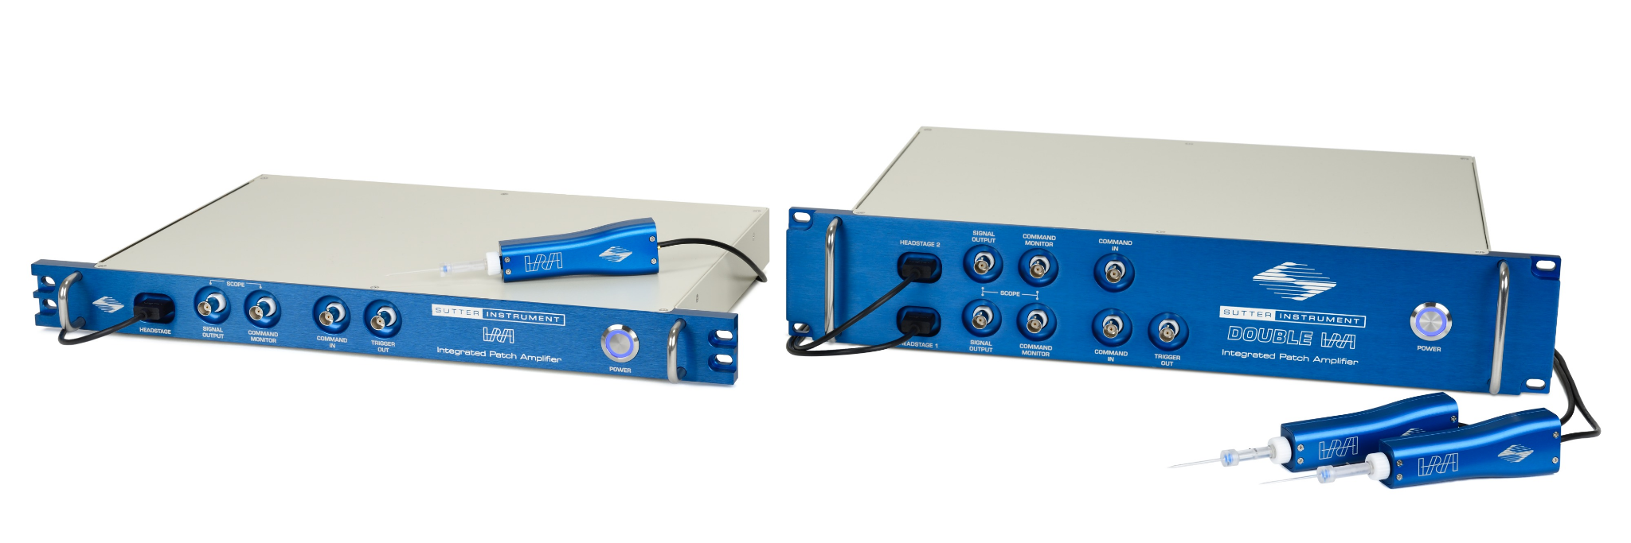
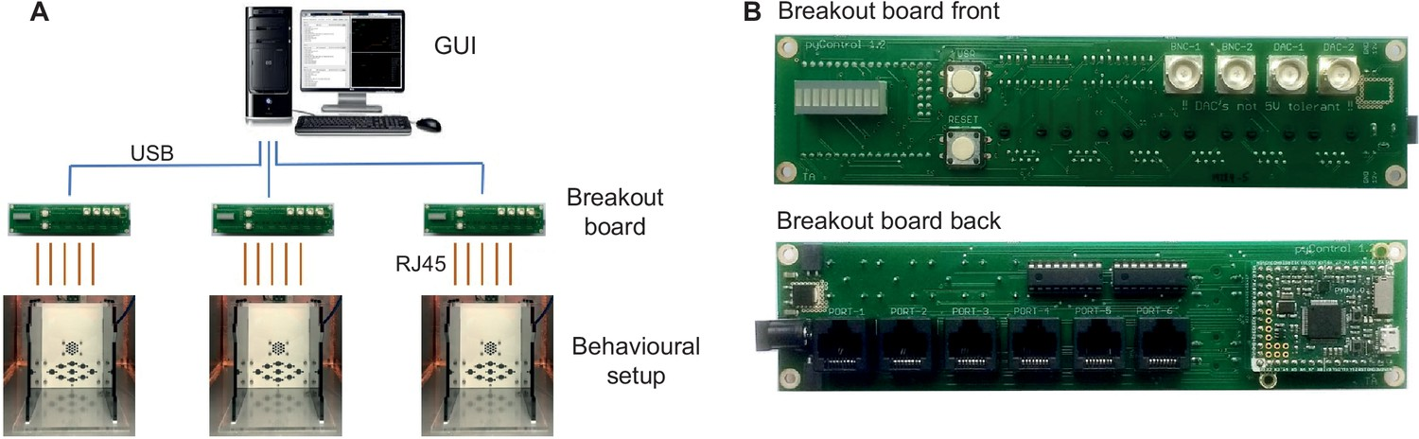
Physical computing & research applications
Examples of projects that use electronics

Slide 4
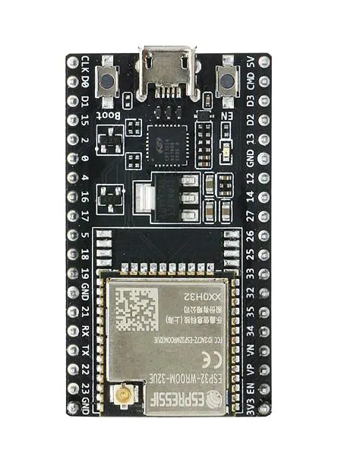
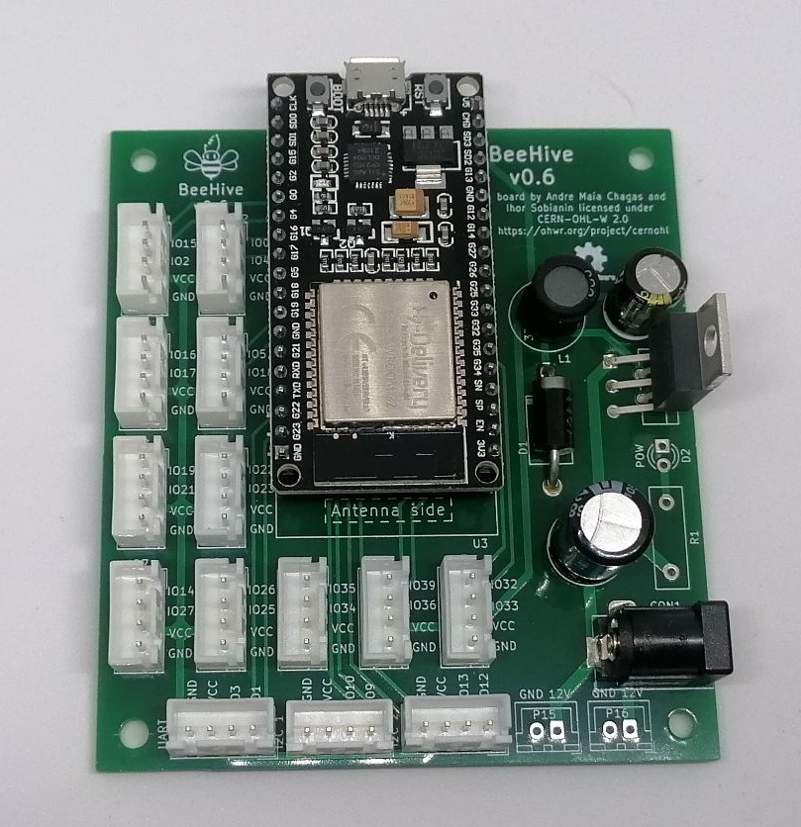
Microcontroller

Slide 5
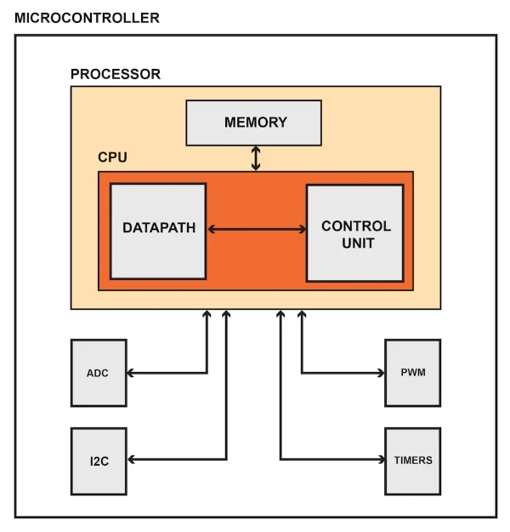
Microcontroller

Slide 6
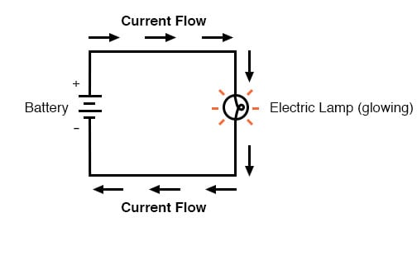
DC circuits
Ohm’s law:
I [A] = U [V] / R [Ohm]

Slide 7
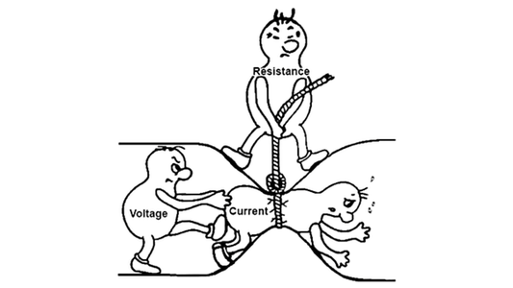
Ohm’s law review

Slide 8
Add info about binary system and how numbers are conveyed in binary

Slide 9
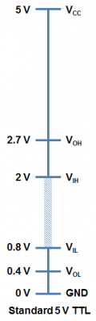
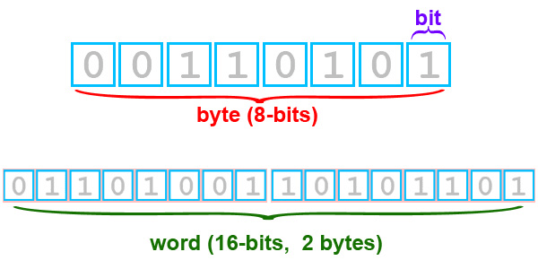
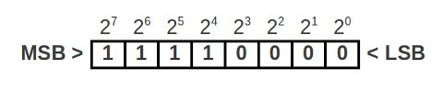
Binary representation-how digital computers communicate
Bits, bytes, words:
Register:

Slide 10
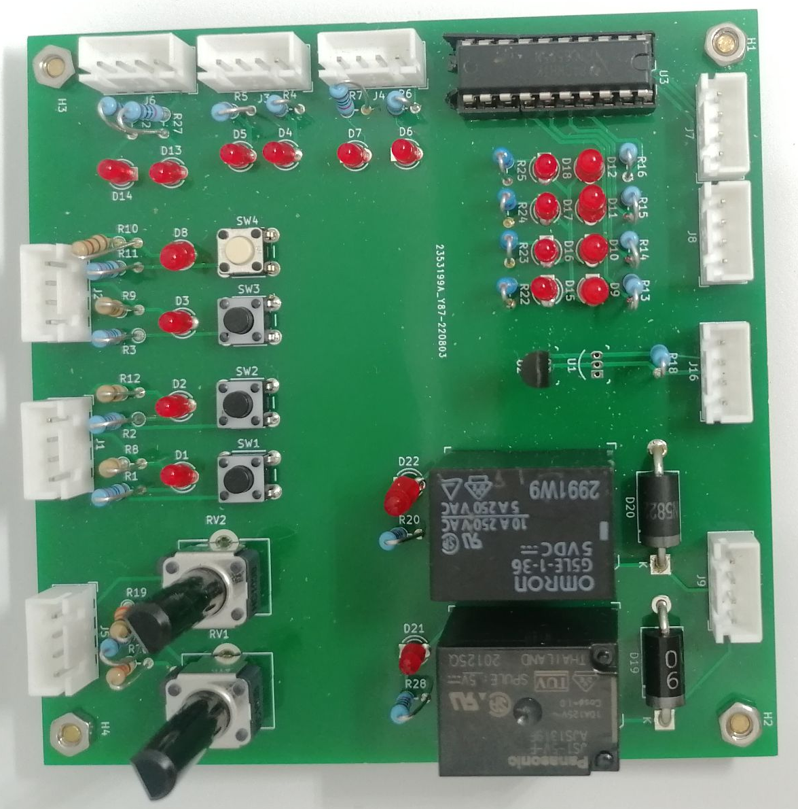
Training board

Slide 11
Connecting things for the first time

Slide 12
Exercise: Digital Output
Blink some leds on the training board!
Steps:
  Connect cables from the main board to appropriate section on the training board
  Make sure to note to which IO pins on the main board the cables are connected.
Now blink the other leds on the board, can you change the amount of time they stay on and off?

Slide 13
Exercise: Digital Input
Detect when the a button was pressed
Steps:
  Connect cables from the main board to appropriate section on the training board
  Make sure to note to which IO pins on the main board the cables are connected

Slide 14
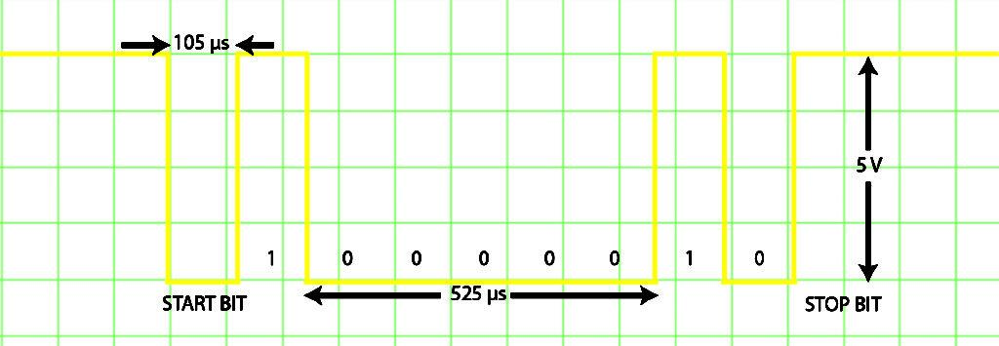
Serial communication

Slide 15
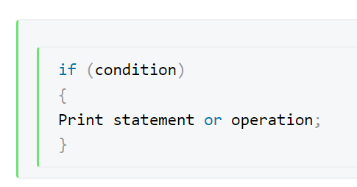
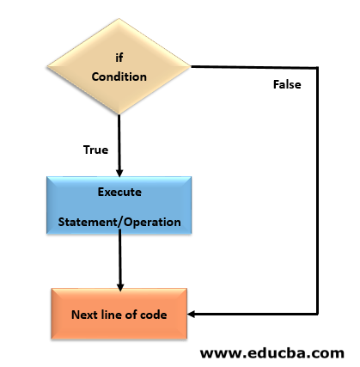
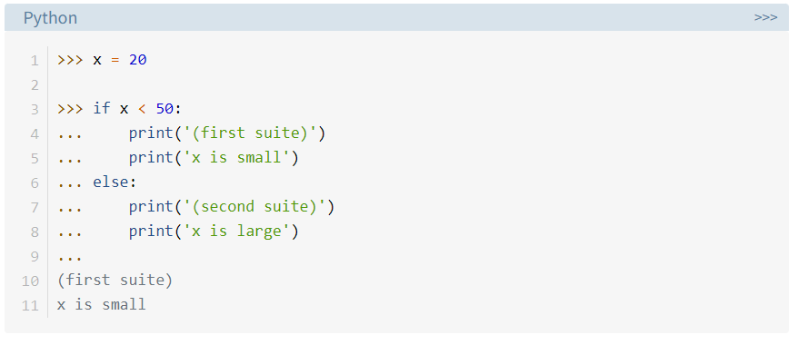
Conditional statements

Slide 16
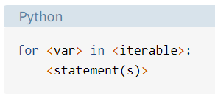
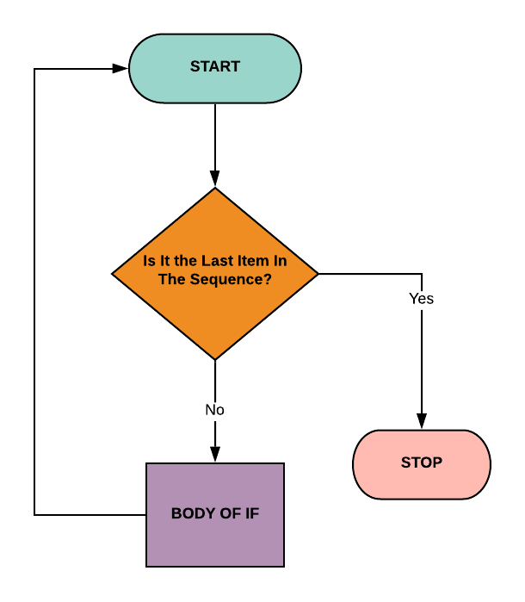
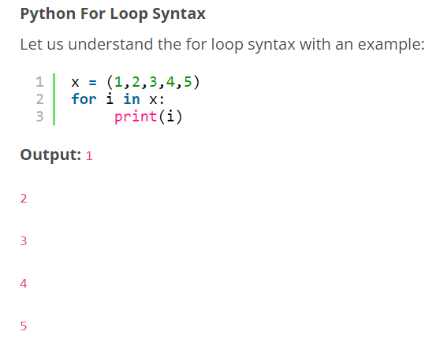
Loops

Slide 17
Exercise: Timing
Press a button when LED is turned ON/OFF
  Does this seem similar to anything in Neurosciences?
  What if we count the time in between the LED turning on and the button being pressed?

Slide 18
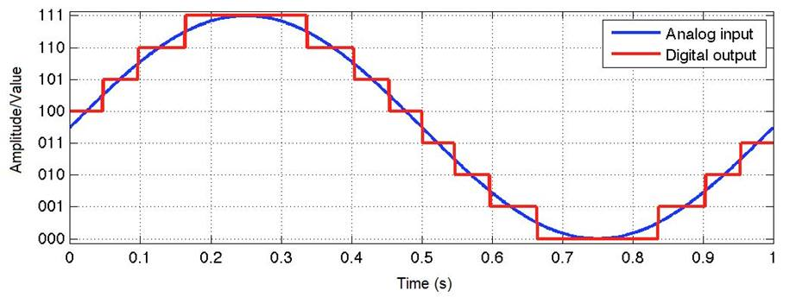
Analog-to-digital converter

Slide 19
Exercise: Analog input
Read from a potentiometer
How do we transform volts to integer values (ADC)

Slide 20
Exercise: Analog output
Dim an led
How do we convert integer values to volts (DAC)

Slide 21



Data Logging
Constraints of microcontrollers
  How much data can be transmitted at a certain amount of time
  Time critical periods in applications
  Record locally (SD card) or remotely (PC)
Working together with PC
  Capture data being transmitted/store it to file
  Different file types.

Slide 22
Exercise: Data Logging
Show how to send data with mpremote code and than point to Dexter’s library.

Slide 23

Q&A - course midpoint
Notes:
Prepare some questions for the students:
What is the advantage of using micropython as a programming language for microcontrollers?
And disadvantages?
What are microcontrollers good for? (as in how do they compare with “regular” computers?
Are computers smart?
What other microcontrollers could be used?
Give us an application example with what you have learned so far

Slide 24
Exercise at home
Please write a small text about what kind of tool you would like to create for your research needs.
  Try to think about how this would be implemented in code
    This can and should be done without coding at a first stage! Create sketches, block diagrams and/or a list of logical steps on what your application needs to do.

Slide 25
BeeHive I
Please share with us the task you thought about at home
  Lets get examples from 2-3 pairs
Are there common points in these tasks?
  If so, do we need to reinvent the wheel every time?
What if we had a system with pre-configured building blocks?

Slide 26
BeeHive I
Beehive presentation
Notes:
Presentation about BeeHive (longer or shorter version depending on the time we have)
Present beehive boards we have so far
Present combinations for actual working systems
Talk about the plugs and GROVE

Slide 27
Exercise: BeeHive I application
Turn on a DC motor/peltier element/fan

Slide 28
BeeHive I other examples
Other boards and actuators/sensors that can be controlled with them.

Slide 29
BeeHive II
Using the existing blocks for your experiments
  Match your task with existing beehive boards

Slide 30
Create your own system
Using the training board and your new coding skill, start implementing the programming logic for your task!

Slide 31
Closing remarks

